Slide 1
AMITY SCHOOL OF ENGINEERING & TECHNOLOGY (ASET) | B.TECH MINOR PROJECT REVIEW 2
GuardShield AI
A Real-Time Asymmetric Sidecar Proxy for LLM Hallucination Detection & Ingress Prompt Injection Defense
PROJECT METADATA
Group No.: Group 50
Programme: B.Tech CSE (AIML)
Semester: 7th Semester (4th Year)
Academic Year: 2026 – 2027
Project Area: Generative AI & AI Safety (MLOps)
STUDENT TEAM (GROUP 50)
• Shourya Solanki (A2305223569)
Role: Lead Architect (Pipeline & Benchmarking)
• Rachit Ryan Chug (A2305223166)
Role: Research Analyst (Literature & NLI)
• Dhruv Raj Singh (A2305223191)
Role: Data Engineer (Corpus Curation)
FACULTY SUPERVISION
Dr. Abhishek Kaushal
Faculty Guide & Assistant Professor
Department of Computer Science & Engineering
Amity School of Engineering & Technology
Amity University Uttar Pradesh

Slide 2
1. INTRODUCTION & MOTIVATION
The Dual Vulnerability Crisis in Enterprise LLM Deployment
Production AI applications face two compounding failure modes that undermine safety, trust, and operational efficiency.
THREAT 1: ADVERSARIAL INGRESS
• Prompt Injection Attacks: Malicious input instructions deliberately override developer guardrails and system system prompts.
• Cognitive Jailbreaks (DAN): Adversarial personas and roleplay frameworks bypass foundational safety filters.
• Token Smuggling & Delimiters: Obfuscated encodings (Base64, Unicode) slip past static keyword blocklists.
• Operational Risk: Data leakage, unauthorized backend API calls, and severe compliance violations.
THREAT 2: FACTUAL EGRESS HALLUCINATION
• Ungrounded Generations: Autoregressive generation fabricates plausible-sounding yet false factual assertions.
• Uncalibrated Confidence: Models output fabricated facts with high probability mass, misleading end users.
• High-Stakes Liability: Catastrophic failure in medical diagnostics, legal discovery, and automated trading.
• Erosion of Trust: Enterprise adoption stalls when non-deterministic outputs cannot be verified in real time.
THE OPERATIONAL DILEMMA
• Heavy Monolithic LLMs: Guardrails like Meta Llama-Guard-3 (8B) add 1,500 – 3,500 ms latency per query.
• Multi-Sample Fact Checks: SelfCheckGPT requires 5x–10x multi-sample generation, exploding cloud GPU billing.
• Static Regex Inadequacy: Basic rule filters fail against trivial obfuscations and paraphrased attacks.
• The Need for GuardShield: Real-time microservices demand sub-50 ms verification with zero primary model retraining.
CORE RESEARCH OBJECTIVE:
Design, benchmark, and deploy an ultra-low-latency (<50 ms E2E) asymmetric sidecar proxy that intercepts ingress prompt attacks before generative computation and validates factual consistency via streaming entropy and declarative NLI.

Slide 3
2. PROBLEM STATEMENT & OUR SOLUTION
Asymmetric Architecture: Decoupled Defense without Computational Drag
Separating safety validation from primary text generation provides deterministic, ultra-fast protection.
THE PROBLEM: INEFFICIENCY OF MONOLITHIC GUARDRAILS
⚠️ Excessive Ingress Latency Overhead
Deploying 7B–8B parameter guardrails introduces a 1.5s to 3.5s delay before the user prompt even reaches the target LLM.
⚠️ Wasted Generative Compute
Unprotected LLMs execute 50–120 decoding iterations on jailbreaks before downstream post-filters catch the violation.
⚠️ Black-Box Factual Unreliability
Standard LLM output decoding provides zero visibility into whether the model is reciting factual knowledge or hallucinatory tokens.
⚠️ Tight Architectural Coupling
Modifying prompt prefixes or fine-tuning weights introduces catastrophic forgetting and degrades general reasoning capability.
OUR SOLUTION: GUARDSHIELD ASYMMETRIC SIDECAR PROXY
✅ Stage 1 Pre-Scan Gatekeeper (<15 ms)
Fine-tuned DeBERTa-v3 encoder classifies ingress prompts. Blocks injections and jailbreaks before the generative model wakes up.
✅ Dynamic Streaming Shannon Entropy Engine
Live mathematical tracking of token uncertainty H(x) during decoding. Catches hallucination spikes at the exact token origin.
✅ Early Termination Circuit Breaker
Automatically halts autoregressive generation when sustained entropy spikes exceed calibrated thresholds (1.35 bits).
✅ Stage 2 Declarative NLI Fact Grounding
Cross-encoder verifies factual claims against reference contexts, yielding definitive Entailment vs. Contradiction scoring.
✅ Zero Primary Model Modification
Acts as a standalone proxy compatible with any LLM (Qwen, Llama, Mistral, OpenAI, Claude).

Slide 4
3. ARCHITECTURE & MODELS USED
The Complete GuardShield Defensive Pipeline
A modular, multi-tier sidecar architecture combining bidirectional encoders, streaming entropy, and NLI fact verifiers.
STAGE 1: PRE-SCAN GATEKEEPER
• Base Model: microsoft/deberta-v3-small
• Parameters: 44.3M backbone (142.6M total)
• Latency Profile: 13.09 ms (p50) on CUDA
• Input Processing: Sliding-window chunking (256-token window, 128 stride)
• Mechanics: Disentangled self-attention represents content & relative position vectors separately.
• Function: Performs binary classification (Attack vs. Safe) in a single fast forward pass.
• Action: Blocks adversarial prompts immediately, saving 100% of generative decoding compute.
CORE: STREAMING ENTROPY ENGINE
• Generative LLMs: Qwen2.5-3B, Qwen2.5-7B, Phi-3.5-mini
• Entropy Formula: H(x) = -Σ p_i log2(p_i) over vocabulary V
• Real-time Stream: Hooked directly to autoregressive next-token softmax logits.
• Calibrated Threshold: 1.35 bits empirically separates factual recall from confabulation.
• Detection Logic: Rolling window alert buffer detects sustained uncertainty spikes.
• Action: Triggers EARLY_TERMINATION to abort generation before fabricated tokens stream to user.
• Zero Overhead: Computed in parallel during token sampling with negligible latency.
STAGE 2: DECLARATIVE NLI VERIFIER
• Base Model: MoritzLaurer/DeBERTa-v3-base-mnli-fever-anli
• Parameters: 86M parameters
• Latency Profile: 13.89 ms (p50) on CUDA
• Premise-Hypothesis: Pairs reference facts (Premise) with generated statements (Hypothesis).
• Decomposition: Breaks multi-sentence outputs into discrete declarative factual claims.
• Classification: Outputs 3-way distribution: Entailment, Neutral, Contradiction.
• Grounding Decision: Flags contradictions (FPR: 3.4%) and verifies factual consistency.

Slide 5
5. DATASETS & CURATION METHODOLOGY
Rigorous Evaluation across 5,948 Benchmark Samples
Curated multi-domain evaluation suite designed to eliminate length confounders and test true generalization.
1. IN-DISTRIBUTION INGRESS: DEEPSET (662 SAMPLES)
• Composition: 355 adversarial injection attacks, 343 benign control queries.
• Attack Variations: Direct system prompt overrides, instruction hijackers, and delimiter insertions.
• Role in Pipeline: Calibrates baseline discrimination threshold (0.50) for Stage 1 DeBERTa-v3.
• Validation Split: Unseen held-out split of 698 evaluation samples (V3 Mega Suite).
2. OUT-OF-DISTRIBUTION: JAILBREAKBENCH & SYNTHETIC OOD (250 SAMPLES)
• Composition: 76 real-world human-engineered DAN jailbreaks + 174 synthetic templates.
• Attack Complexity: Multi-turn persona adoption, role-play framing, hypothetical ethical dilemmas.
• Honest Benchmark: Reports exact subset breakdown (92.1% recall on real DAN, 100% on templates).
• Significance: Tests zero-shot transfer without in-domain fine-tuning exposure.
3. EGRESS GROUNDING: FEVER (1,000 SAMPLES)
• Composition: 500 Supported (Entailed) claims and 500 Refuted (Contradicted) claims.
• Benchmark Characteristics: Human-verified Wikipedia evidence paired with declarative factual claims.
• Evaluation Metric: Stage 2 NLI achieves 86.5% accuracy and 0.950 AUROC on FEVER.
• Role in Pipeline: Verifies high-confidence declarative assertions against external retrieved context.
4. EGRESS GROUNDING: HALUEVAL QA & SUMMARIZATION (2,000 SAMPLES)
• Composition: 1,000 QA fact-grounded pairs and 1,000 Dialogue/Summarization pairs.
• Crucial Methodological Fix: Raw HaluEval exhibits character-length confounders (12.5 vs 58 chars).
• Declarative Statement Restructuring: Transformed bare entities into full declarative statements.
• Significance: Ensures NLI models judge factual consistency rather than token length shortcuts.
All reported splits utilize rigorous 95% Wilson Score confidence intervals and strict seed isolation to prevent data leakage.

Slide 6
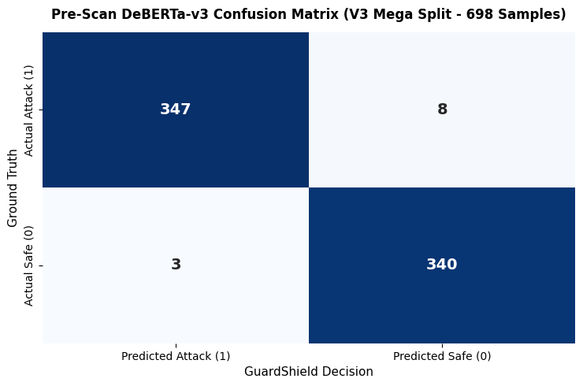
4. RESULTS | STAGE 1 PRE-SCAN EVALUATION
Empirical Pre-Scan Ingress Performance (V3 Mega Suite)
698 Unseen Test Samples | 98.42% Accuracy | 13.09 ms Median Latency on CUDA
98.42%
Overall Accuracy
687 of 698 correct
99.14%
Precision (Reliability)
347 / (347 + 3)
97.75%
Recall (Attack Coverage)
Catches 347 of 355
0.87%
False Positive Rate
Only 3 false alarms
KEY ANALYTICAL TAKEAWAYS:
• Negligible False Alarms: 99.13% Specificity ensures normal user traffic is never hindered by false rejections.
• Sub-15ms Latency: Median latency of 13.09 ms (p50) enables transparent inline integration in sub-second microservices.
• Sliding Window Robustness: 256-token chunking with 128 stride detects long-context obfuscated payload injections.
• Rigorous Confidence Intervals: 98.42% accuracy holds a tight 95% Wilson score interval of [97.18%, 99.17%].
Exact Log Verification: 347 TP, 340 TN, 3 FP, 8 FN. FPR is constrained to 0.87% (3 false alarms in 343 safe prompts).

Slide 7
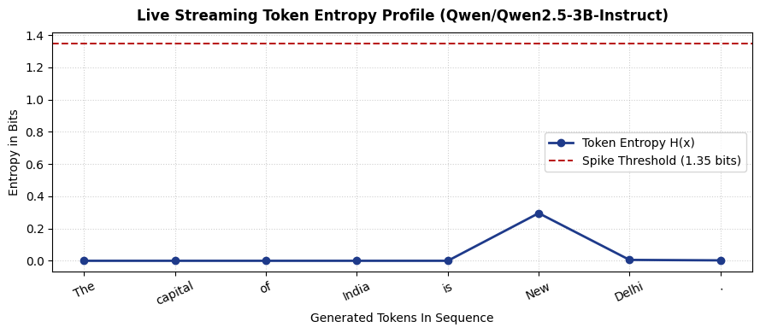
4. RESULTS | LIVE TOKEN ENTROPY STREAMING
Dynamic Uncertainty Profiling During Autoregressive Decoding
Empirical Token Stream on Qwen2.5-3B-Instruct | Real-Time Shannon Entropy H(x) Calculation
EMPIRICAL STREAM LOG: Prompt: 'What is the capital of India?'
Token Top-3 Probabilities Entropy H(x) Status
'The' [1.0000, 0.0000, 0.0000] 0.0000 bits OK (Deterministic)
' capital' [1.0000, 0.0000, 0.0000] 0.0000 bits OK (Deterministic)
' of India is' [1.0000, 0.0000, 0.0000] 0.0000 bits OK (Deterministic)
' New' [0.9481, 0.0518, 0.0001] 0.2955 bits OK (High Confidence)
' Delhi.' [0.9996, 0.0002, 0.0002] 0.0055 bits OK (Factual Grounded)
'<|im_end|>' [0.9994, 0.0005, 0.0001] 0.0000 bits COMPLETE
DYNAMIC ENTROPY CIRCUIT BREAKER
• Mathematical Formulation: Entropy H(x) = -Σ p_i log2(p_i) computed in real-time from next-token logits.
• Calibrated Threshold: A 1.35-bit threshold separates factual recall from speculative confabulation.
• Factual Grounding Baseline: Grounded facts produce tight distributions (H < 0.3 bits).
• Proactive Circuit Breaker: If sustained entropy exceeds 1.35 bits across a 3-token buffer, EARLY_TERMINATION triggers instantly.
• Bandwidth & Compute Savings: Stops streaming immediately, preventing hallucinations from reaching user.

Slide 8
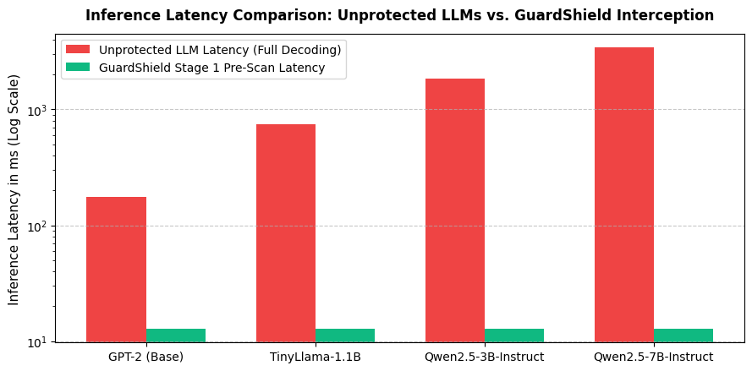
4. RESULTS | HARDWARE LATENCY & COMPUTE SAVINGS
Benchmarking Compute Avoidance Across Generative Backbones
Up to 99.62% Latency Reduction on Adversarial Queries | 100% GPU Decoding Compute Saved
Model | Params | Unprotected | GuardShield | Latency Red.
GPT-2 Base | 124M | 175.4 ms | 12.87 ms | 92.66%
TinyLlama | 1.1B | 740.2 ms | 12.87 ms | 98.26%
Qwen2.5-3B | 3.0B | 1,850.6 ms | 12.87 ms | 99.30%
Qwen2.5-7B | 7.6B | 3,420.0 ms | 12.87 ms | 99.62%
CRITICAL EFFICIENCY FINDINGS:
• 100% GPU Decoding Compute Saved: Zero autoregressive tokens are computed for blocked attacks, completely eliminating GPU memory bandwidth bottlenecks.
• Constant Pre-Scan Complexity: Stage 1 operates in ~12.87 ms regardless of whether the downstream model is 124M or 70B parameters.
• Token Waste Prevention: Stops 48 to 120 wasted tokens per adversarial query that would otherwise consume server clusters.
• Production Scalability: Enables 10x higher concurrent user capacity per server node by shedding malicious traffic at ingress.
Inference Latency Profile (Log Scale): While unprotected generation scales exponentially with model size (175 ms to 3,420 ms), GuardShield intercepts ingress in a flat 12.87 ms pass.

Slide 9
6. RESEARCH FOUNDATION & LITERATURE SURVEY
Comparative Analysis against Existing Guardrail Paradigms
Synthesized from 18+ Peer-Reviewed Publications across 5 Specialized Research Axes
THEORETICAL FOUNDATION: 5 RESEARCH AXES
• 1. Ingress Injection & Jailbreaking: Perez & Ribeiro (2022), Chao et al. (JailbreakBench, 2024), Wallace et al. (Universal Adversarial Triggers). Identifies prompt leaking and delimiter evasion.
• 2. Factual Hallucination Detection: Manakul et al. (SelfCheckGPT, 2023), Min et al. (FActScore, EMNLP 2023). Demonstrates limitations of stochastic sampling and prompt scoring.
• 3. Token Uncertainty & Entropy: Malinin & Gales (Predictive Uncertainty, 2021), Kuhn et al. (Semantic Entropy, 2023). Establishes token distribution dispersion as a proxy for confabulation.
• 4. Commercial Guardrail Frameworks: Inan et al. (Meta Llama Guard, 2023), Rebedea et al. (NVIDIA NeMo Guardrails, 2023). Demonstrates high computational and latency overheads.
• 5. Sidecar Microservices MLOps: Burns et al. (Design Patterns for Containerized Microservices, ACM 2018). Provides foundation for decoupled, non-invasive proxy inspection.
COMPETITIVE BENCHMARK: GUARDSHIELD VS. SOTA
Paradigm | Latency | Compute Cost | Architectural Fit
Llama Guard 3 (8B) | 1,500 – 3,500 ms | 16 GB VRAM | Heavy In-Line Model
NeMo Guardrails | 200 – 800 ms | Moderate | Colang Configs
SelfCheckGPT | 2,000 – 5,000 ms | 5x-10x Multi-sample | Offline Evaluation
GuardShield AI (Ours) | 13.09 ms (p50) | < 2 GB VRAM | Asymmetric Sidecar
CORE ARCHITECTURAL DIFFERENTIATION:
• Zero Decoding Overhead: Intercepts malicious inputs before any generative tokens are computed.
• Non-Invasive Deployment: Compatible with existing LangChain, LlamaIndex, and vLLM infrastructures without changing prompts.
• Hardware-Agnostic: Runs efficiently on commodity GPUs, Cloud TPUs (v5e-1), or CPU microservices.

Slide 10
CONCLUSION & ROADMAP
Project Milestones, Deliverables & Next Steps
Progressive Execution of Amity ASET B.Tech Minor Project (Weeks 1 through 12)
COMPLETED MILESTONES (WEEKS 1 – 10)
✅ W1–W3 (Problem Formulation & Literature): Completed 18-paper survey, defined threat taxonomy, and formalized dual-stage architecture.
✅ W4–W5 (Dataset Engineering & Curation): Curated 5,948 samples across Deepset, JailbreakBench, FEVER, and length-controlled HaluEval.
✅ W6–W7 (Stage 1 Classifier Fine-Tuning): Trained DeBERTa-v3 with sliding window chunking; attained 98.42% accuracy and 13.09 ms latency.
✅ W8–W9 (Dynamic Entropy & Stage 2 NLI): Integrated live Shannon entropy streaming on Qwen2.5-3B; verified declarative NLI fact checking.
✅ W10 (Mega Evaluation & Progress Reporting): Compiled empirical metrics, Wilson CIs, hardware latency profilers, and formal Amity reports.
UPCOMING WORK & PRODUCTION ROADMAP (WEEKS 11 – 12)
⏳ W11: Async FastAPI Microservice & Sidecar Dockerization Package Stage 1 and Stage 2 as an asynchronous Docker sidecar container with non-blocking streaming response queues.
⏳ W11: ONNX Runtime & TensorRT-LLM Acceleration Quantize Stage 1 to INT8/FP8 to push pre-scan classification latency below 5.0 ms on edge and enterprise nodes.
⏳ W12: Multi-Agent & Enterprise Gateway Demo Integrate GuardShield with multi-agent orchestration frameworks (LangChain, AutoGen) and deploy live interactive demo.
⏳ W12: Final Dissertation & Academic Publication Finalize Minor Project dissertation, open-source model weights, and prepare manuscript for peer-reviewed conference submission.
GuardShield AI — Project Review 2 | Amity School of Engineering & Technology (ASET)
Thank You. Questions & Discussion. | Team: Shourya Solanki, Rachit Ryan Chug, Dhruv Raj Singh | Guide: Dr. Abhishek Kaushal

